Slide 1
Less is more.
Don't be afraid of empty space.

Slide 2
Good presentation material reinforces your expertise.
When the presenter has a clear message and the support material is easy for the audience to follow, it's easy for them to focus and be impressed!
Allocate time for preparing visually clear presentation materials.
Use always Vaisala's new PowerPoint presentation template.
Start creating your presentation on a blank new template.
Do not copy pages from your old presentations!

Slide 3
More slides, less text to read.
A few slides do not make a short presentation, and many slides do not make a long one.

Slide 4
Inspirational headline
A headline that provokes thought and inspires the audience and you, instead of causing boredom.

Slide 5
Highlight the most important messages with large letters and colorful backgrounds.

Slide 6

A key message, such as an argument, fits excellently here.
The image should reinforce the message.

Slide 7

An image always carries a strong message.
Choose only images for the presentation material that are related to the content of the presentation.
Remember to utilize the selected image in the slide when speaking.
You may not necessarily need bullet points when condensing your messages.

Slide 8

The slide's title is news, it should contains information!
Ensure your images are high quality and you have the right to use them.
Do not choose images from the internet…like I did…

Slide 9
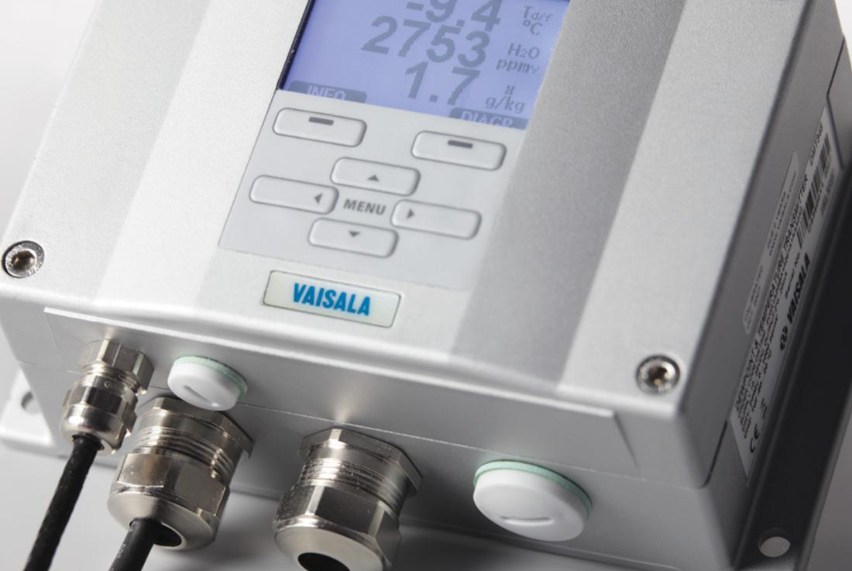
What should be understood from the image?
Short sentences are easy to read.
Remember, the audience should be listening to you, not reading the presentation material.

Slide 10

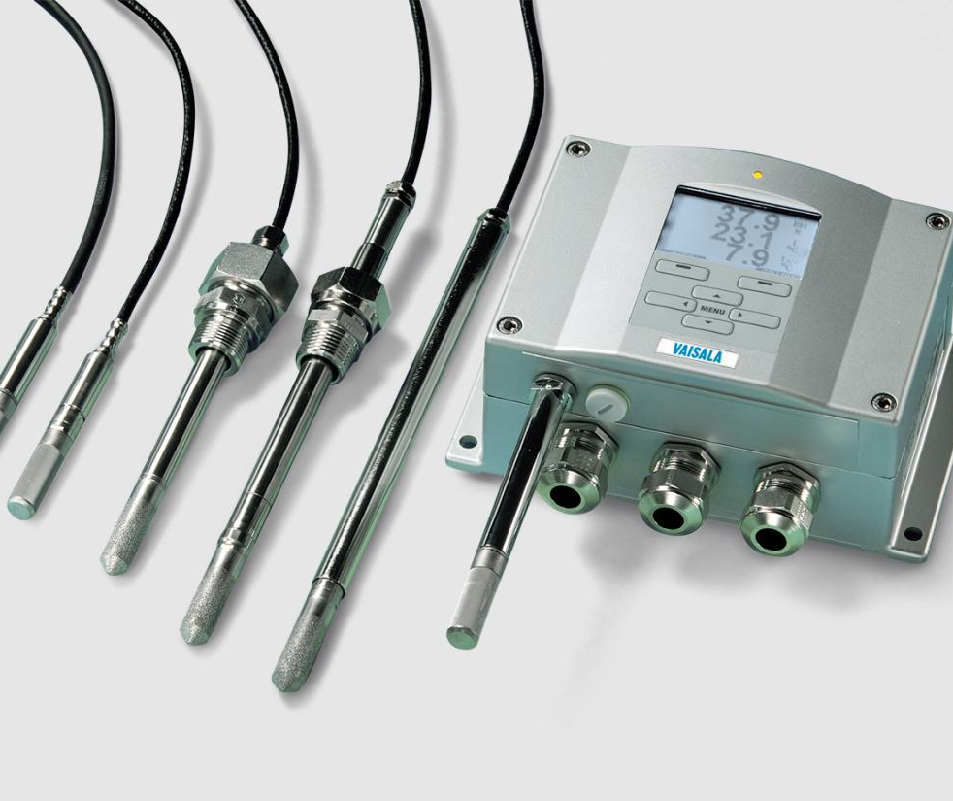
The slide's title is news, it contains information!
Subheadline
The caption below the image can also contain information.
Summarize here with a sentence or two and supported by the picture.
.
A couple of two lines of text is enough for one photo.
A couple of two lines of text is enough for one photo.

Slide 11



The use of your company's own symbols is recommended
In a stylish presentation, texts and images are aligned with each other.
A PowerPoint template facilitates the creation of a stylish presentation as you learn to use it and master the tools of the program.
In a stylish presentation, texts and images are aligned with each other.
A PowerPoint template facilitates the creation of a stylish presentation as you learn to use it and master the tools of the program.
In a stylish presentation, texts and images are aligned with each other.
A PowerPoint template facilitates the creation of a stylish presentation as you learn to use it and master the tools of the program.

Slide 12
This slide template might be too challenging for presentation material.
It tempts you to write a lot of text.
It tempts you to write a lot of text.
The font size is so small that it's difficult for the audience to read the text while listening to you.
Use it judiciously and only 1-3 times per presentation.
Example sentences to see what the slide looks like when a lot of text is written on it. Does this slide inspire you as a speaker, and how about as a listener?
If you use this slide, remember to use the animation.
The font size is so small that it's difficult for the audience to read the text while listening to you.
Use it judiciously and only 1-3 times per presentation.
Example sentences to see what the slide looks like when a lot of text is written on it. Does this slide inspire you as a speaker, and how about as a listener?
If you use this slide, remember to use the animation.

Slide 13
The name of the chart can be in the title, allowing you to remove it from the chart box.
Clearly mark the most important points.
Increase the size of the chart's texts so that they are easy to read.
Present tables in their entirety with precision.
You can add empty lines between points to make sentences stand out more from each other.
5
4,4

Slide 14
Less text clarifies the key messages for the audience
Strengthen the lines so that they are easy to see from a distance.
Clearly mark the most important points.
Utilize animations when presenting slides.

Slide 15
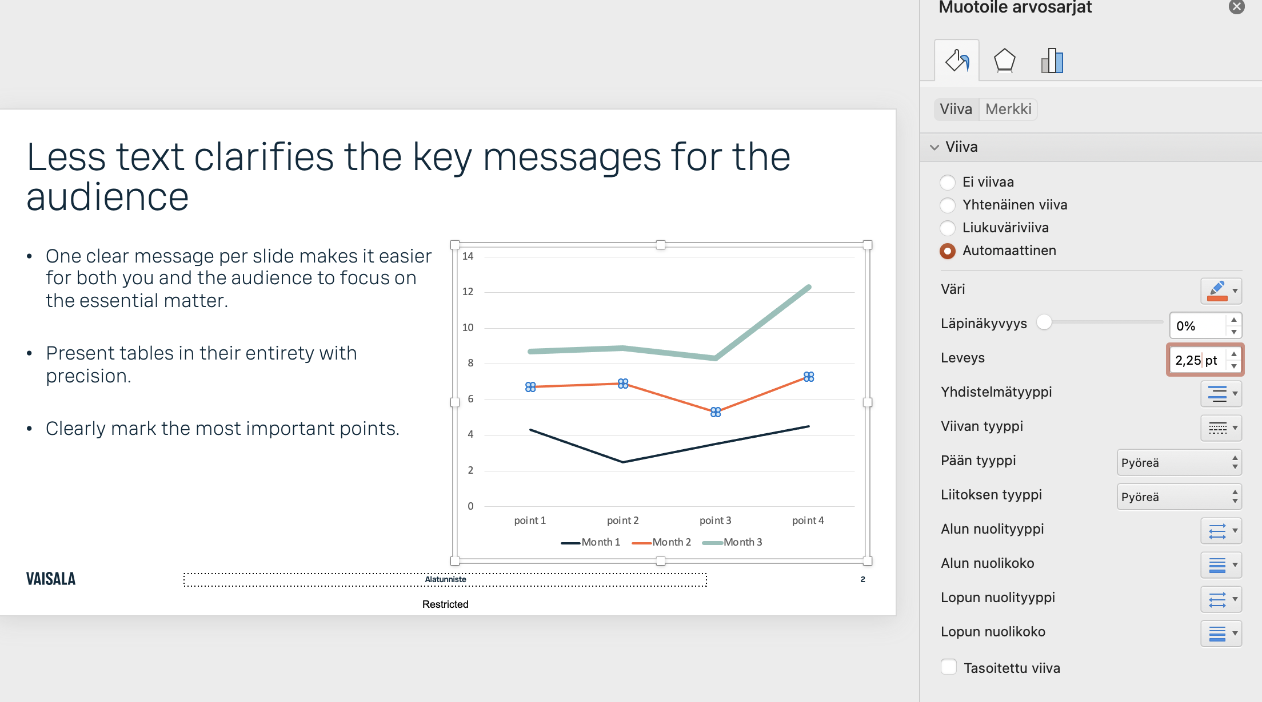
Lines and arrows: minimum thickness of 5pt.

Slide 16
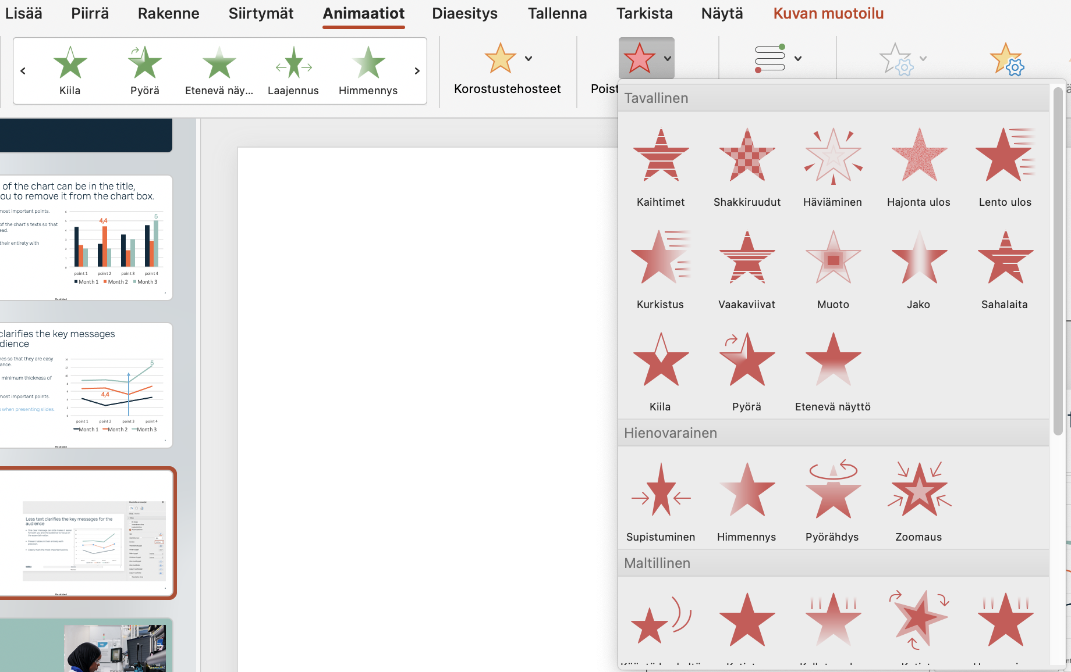
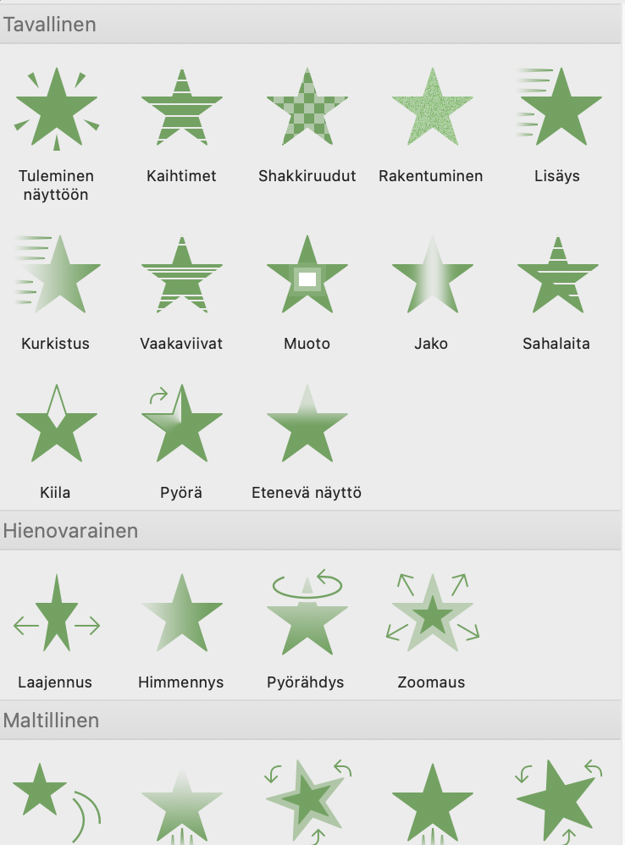
Animation makes it easier for the audience to follow the presentation. -So learn how to use animations!
Choose only one animation style so that it doesn't attract too much attention.

Slide 17
The subtitle page moves the listener from one issue to another.
A section title slide is like the windshield wipers in a car.
1

Slide 18
You can write a title for the next topic (a word or two)
…or a sentence that helps you lead the audience into a new topic.
2

Slide 19
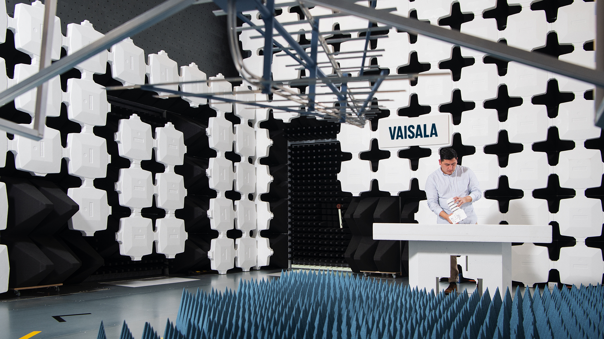
Do not place texts over images as they are hard to read.

Slide 20
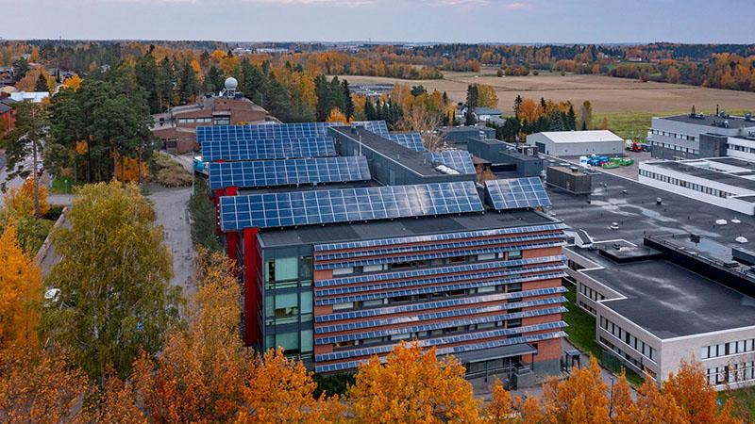
Do not place texts over images as they are hard to read.

Slide 21
This may not align with your brand's style, but this way, the text is easily readable and the image is visible too.

Slide 23

A good image for the last slide of the presentation if you don't have a powerful closing statement.

Slide 24

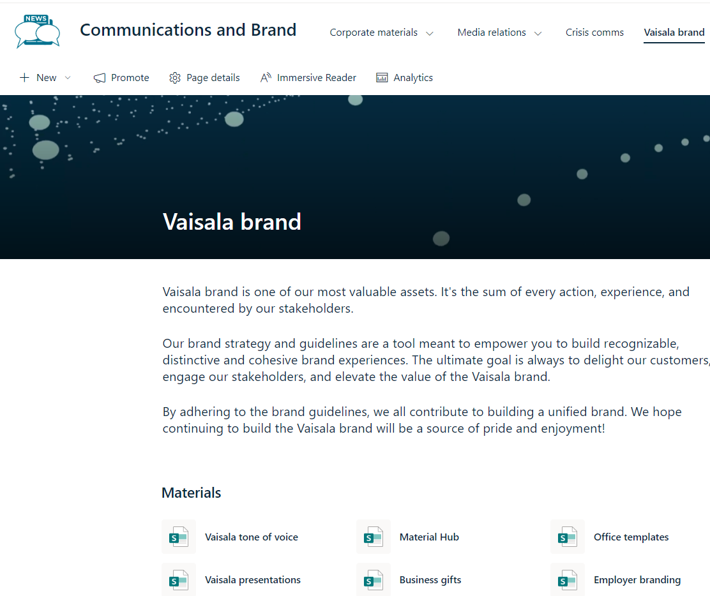
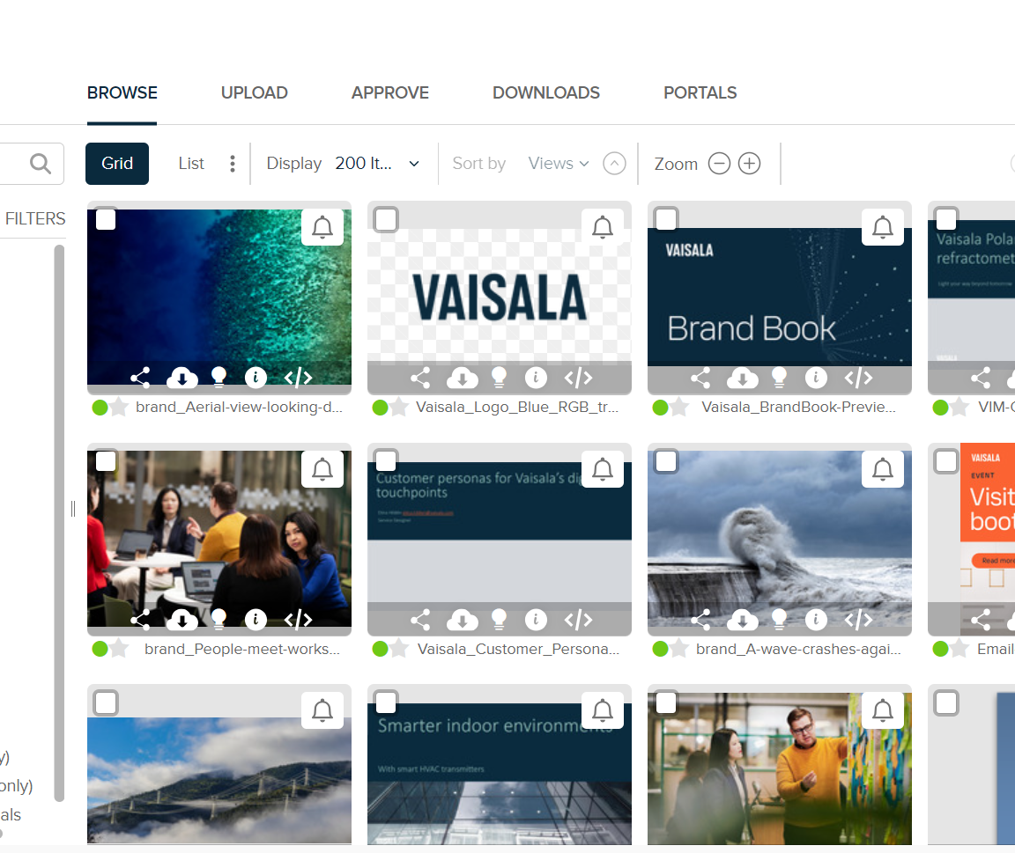
Vaisala Brand Book
Brand page on Vintra
Material Hub & Tone of voice eLearning
https://brand.vaisala.com/
https://vaisalaworks.sharepoint.com/sites/vintra-marcomms/SitePages/Brand-Corporate-Material.aspx
https://materialhub.vaisala.com/
https://mylearning.vaisala.com/pages/description.jsf?menuId=380259#/users/@self/catalogues/628951/courses/629269/description

Slide 25
Less is more.
Clear messages make an impact!

Slide 26
Notes:
Thank you for joining this presentation
Let’s discuss how we can take every measure for the planet – together

